Slide 1
Acceptance Testing
Course Code: CSC4133
Course Title: Software Quality and Testing
Dept. of Computer Science
Faculty of Science and Technology
Lecturer No: | 23 | Week No: | 13 | Semester:
Lecturer: | Name & email

Slide 2
Lecture Outline
Basic idea
Types of Acceptance Testing
Objectives of Acceptance Testing
Acceptance Criteria
Selection of Acceptance Criteria
Acceptance Test Plan
Acceptance Test Execution
Acceptance Test Report

Slide 3
Objectives and Outcomes
Objectives: To understand the basic concept of acceptance testing, to understand different types of acceptance testing, to understand objectives of acceptance testing, to understand different types of acceptance criteria and the procedure of selection of acceptance criteria, to understand acceptance test execution process and generation of acceptance test report.
Outcomes: Students are expected to be able to explain acceptance testing, be able to explain different types of acceptance criteria and select acceptance criteria based on the system type, be able to explain the procedure of executing acceptance testing and preparation of acceptance test report.

Slide 4
Basic Idea
Acceptance testing is a formal testing conducted to determine whether a system satisfies its acceptance criteria
Focus is the assessment of software acceptance by users
Performed by customers/end users (preferably)
− But there are other options
Verifies functionality and usability of the software
Conducted prior to software being released to live operation

Slide 5
Basic Idea
Acceptance testing is a formal testing with respect to user needs, requirements, and business processes conducted to determine whether or not a system satisfies the acceptance criteria and to enable the user, customers or other authorized entity to determine whether or not to accept the system.
Acceptance Testing is a level of the software testing where a system is tested for acceptability.
The purpose of this test is to evaluate the system’s compliance with the business requirements and assess whether it is acceptable for delivery.

Slide 6
Basic Idea
Acceptance testing is primarily intended to demonstrate that the software complies with its requirements. This type of testing is black box testing.
These tests have been planned based on the requirements as approved by the user/customer.
At this level of testing, the software should be in a sufficiently defect-free state to permit the emphasis to change.
Whenever possible, it is performed by actual intended users of the system.
Acceptance testing is usually the last step before the user/customer takes the possession of the software.

Slide 7
Basic Idea
In most organized development in mature software organizations, some form of acceptance testing is usually performed as the final sub-phase of testing to determine if the product should be released.
A product is ready to be delivered to the customer after the system test group is satisfied with the product by performing system-level tests.
Customers execute acceptance tests based on their expectations from the product. However, it is not uncommon for someone to have a dual role as a customer and a user. The service provider needs to ensure that the product meets certain criteria before the provider makes the services available to the general public.

Slide 8
Basic idea
Acceptance testing is a formal testing conducted to determine whether a system satisfies its acceptance criteria –the criteria the system must satisfy to be accepted by the customer.
− It helps the customer to determine whether or not to accept the system
− The customer generally reserves the right to refuse to take delivery of the product if the acceptance test cases do not pass

Slide 9
Types of Acceptance Testing
There are two categories of acceptance testing:
User Acceptance Testing (UAT)
Business Acceptance Testing (BAT)

Slide 10
Types of Acceptance Testing
User Acceptance Testing (UAT): It is conducted by the customer to ensure that system satisfies the contractual acceptance criteria before being signed-off as meeting user needs.
− Actual planning & execution of the acceptance tests do not have to be undertaken directly by the customer. Often third-party consulting firms offer their services to do this task.

Slide 11
Types of Acceptance Testing
Business Acceptance Testing (BAT): It is undertaken within the development organization of the supplier to ensure that the system will eventually pass the UAT.
− It is a rehearsal of UAT at the premises of the supplier.
− The development organization of the supplier derives and executes test cases from the client’s contract, which include the acceptance criteria.

Slide 12
Objectives of Acceptance Testing
Major objectives of acceptance testing:
Confirm that the system meets the agreed upon criteria
Identify and resolve discrepancies, if there is any
Determine the readiness of the system for cut-over to live operations

Slide 13
Acceptance Criteria
The acceptance criteria are defined on the basis of the following
attributes:
Functional Correctness and Completeness
Accuracy
Data Integrity
Data Conversion
Backup and Recovery
Competitive Edge
Usability
Performance
Stress
Reliability and Availability
Maintainability and Serviceability
Robustness
Timeliness
Confidentiality and Availability
Compliance
Installability and Upgradability
Documentation
Scalability

Slide 14
Selection of Acceptance Criteria
The acceptance criteria provide a broad idea about customer needs & expectations, but those are too many and very general.
The customer needs to select a subset of the quality attributes and prioritize them to suit their specific situation.
When the customer & software vendor reach an agreement on the acceptance criteria, both parties must keep in mind that satisfaction of the acceptance criteria is a trade-off between cost and quality.

Slide 15
Selection of Acceptance Criteria
Many organizations associated with different application domains have selected & customized existing quality attributes to define quality for themselves –taking into consideration their specific business & market situation.
Formulation of acceptance criteria is governed by the business goals of the customer’s organization.
IBM use the quality attribute list – CUPRIMDS for their products –– Capability, Usability, Performance, Reliability, Installation, Maintenance, Documentation, and Service

Slide 16
Selection of Acceptance Criteria
Prioritization scheme is often used in specific application domains –
Web-based applications ➔ reliability, usability, security, availability, scalability, maintainability
Word processor software ➔ usability & maintainability take precedence over performance & reliability
Real-time systems ➔ safety, reliability

Slide 17
Acceptance Test Plan
Planning for acceptance testing begins as soon as the acceptance criteria are known. Early development of an acceptance test plan(ATP) gives us a good picture of the final product.
Emphasis must be put on the notion that the system works according to the customer’s expectations in developing an acceptance test plan, rather than just passing comprehensive testing.
An ATP needs to be written & executed by the customer’s special user group.
ATP is reviewed & approved by the relevant groups, such as the marketing, customer support, and SQA groups. It can be shared with system supplier organization.

Slide 18
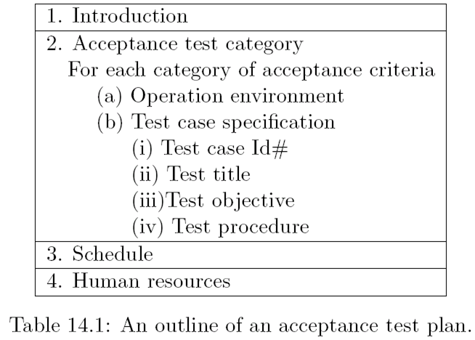
Sample Acceptance Test Plan

Slide 19
Acceptance Test Execution
The acceptance test cases are divided into two subgroups:
− The first subgroup consists of basic test cases, and
− The second subgroup consists of test cases that are more complex to execute

Slide 20
Acceptance Test Execution
The acceptance tests are executed in two phases:
− In the first phase, the test cases from the basic test group are executed.
− If the test results are satisfactory then the second phase, in which the complex test cases are executed, is taken up.
− In addition to the basic test cases, a subset of the system-level test cases are executed by the acceptance test engineers to independently confirm the test results.

Slide 21
Acceptance Test Execution
Acceptance test execution activity includes the following detailed actions:
The developers train the customer on the usage of the system
The developers and the customer co-ordinate the fixing of any problem discovered during acceptance testing
The developers and the customer resolve the issues arising out of any acceptance criteria discrepancy

Slide 22
Acceptance Test Execution
The acceptance test engineer may create an Acceptance Criteria Change (ACC) document to communicate the deficiency in the acceptance criteria to the supplier.
An ACC report is generally given to the supplier’s marketing department through the on-site system test engineers.
A representative format of an ACC document is shown in Table 14.2.

Slide 23
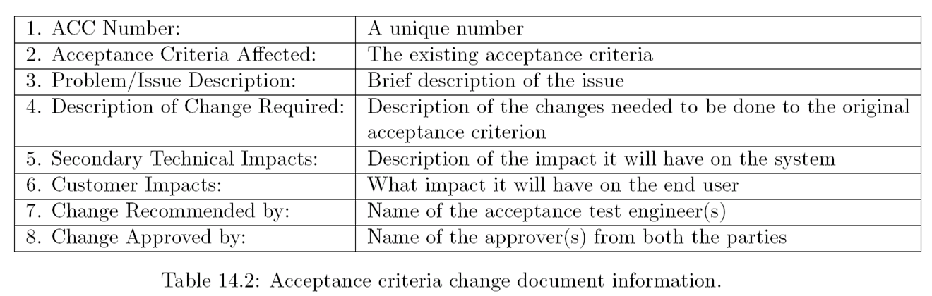
Acceptance Criteria Change (ACC) document

Slide 24
Acceptance Test Report
The acceptance test activities are designed to reach one of three conclusions:
Accept the system as delivered
Accept the system after the requested modifications have been made
Do not accept the system

Slide 25
Acceptance Test Report
Usually some useful intermediate decisions are made before making the final decision.
− A decision is made about the continuation of acceptance testing if the results of the first phase of acceptance testing is not promising.
− If the test results are unsatisfactory, changes will be made to the system before acceptance testing can proceed to the next phase.

Slide 26
Acceptance Test Report
During the execution of acceptance tests, the acceptance team prepares a test report on a daily basis. [ A template of the test report is given in Table 14.3 ]
The test report is reviewed on a daily basis to understand the status and progress of acceptance testing. If serious problems are encountered, project manager flags the issues to senior management.
At the end of the first and the second phases of acceptance testing, an acceptance test report is generated (which is outlined in Table 14.4) by the test team leader.

Slide 27
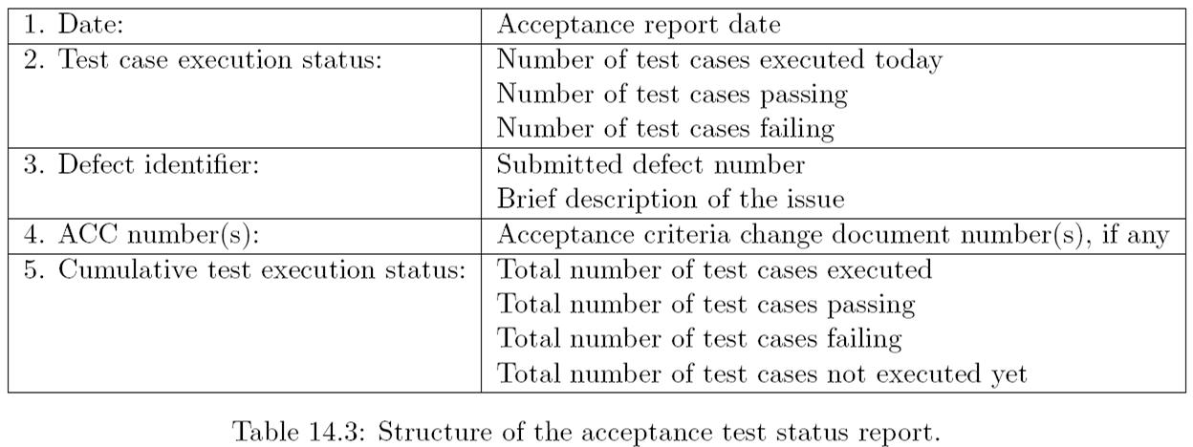
Acceptance Test Status Report

Slide 28
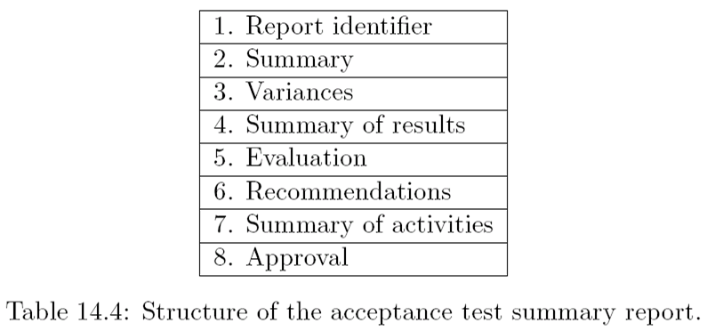
Acceptance Test Summary Report

Slide 29
Books
Software Testing and Quality Assurance: Theory and Practice, by Kshirasagar Naik, Priyadarshi Tripathy

Slide 30
References
Software Quality Engineering: Testing, Quality Assurance and Quantifiable Improvement, by Jeff

